Slide 1
Mission Hospital Case Study
Mohd Rehan
Phil Greene
Sheethal Sridhar
Shubham Puri

Slide 2
Initial Data Processing
Creatinine: Since it is not related to cardiology eliminated the column
https://blog.biostrap.com/posts/creatine-and-its-effects-on-the-heart
Missing values found in Low and High BP, Urea and Hb were removed
Remove alert column as approximately all patient are brought in alert condition

Slide 3
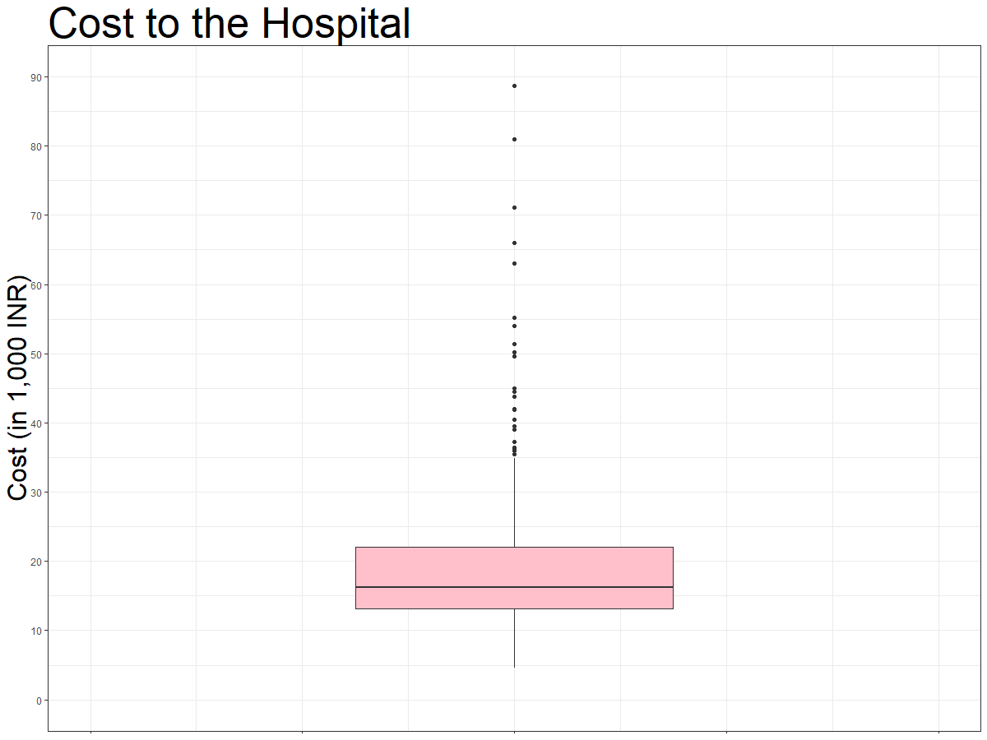
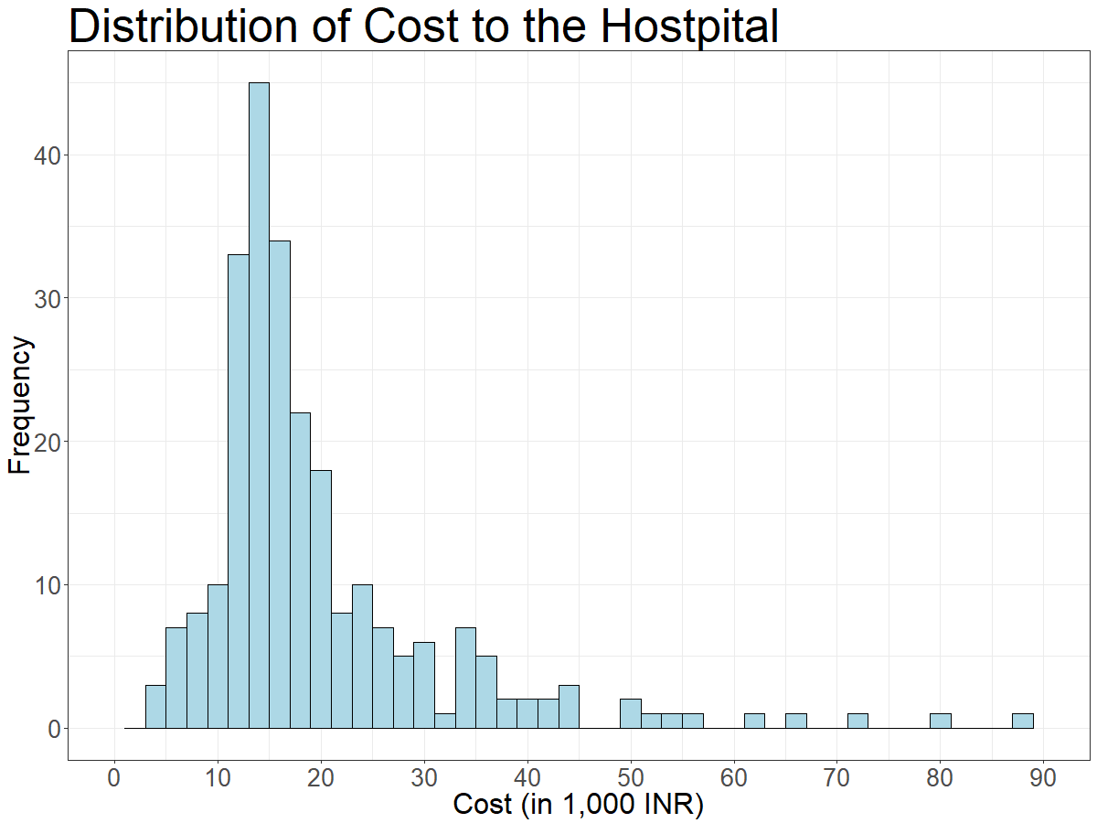
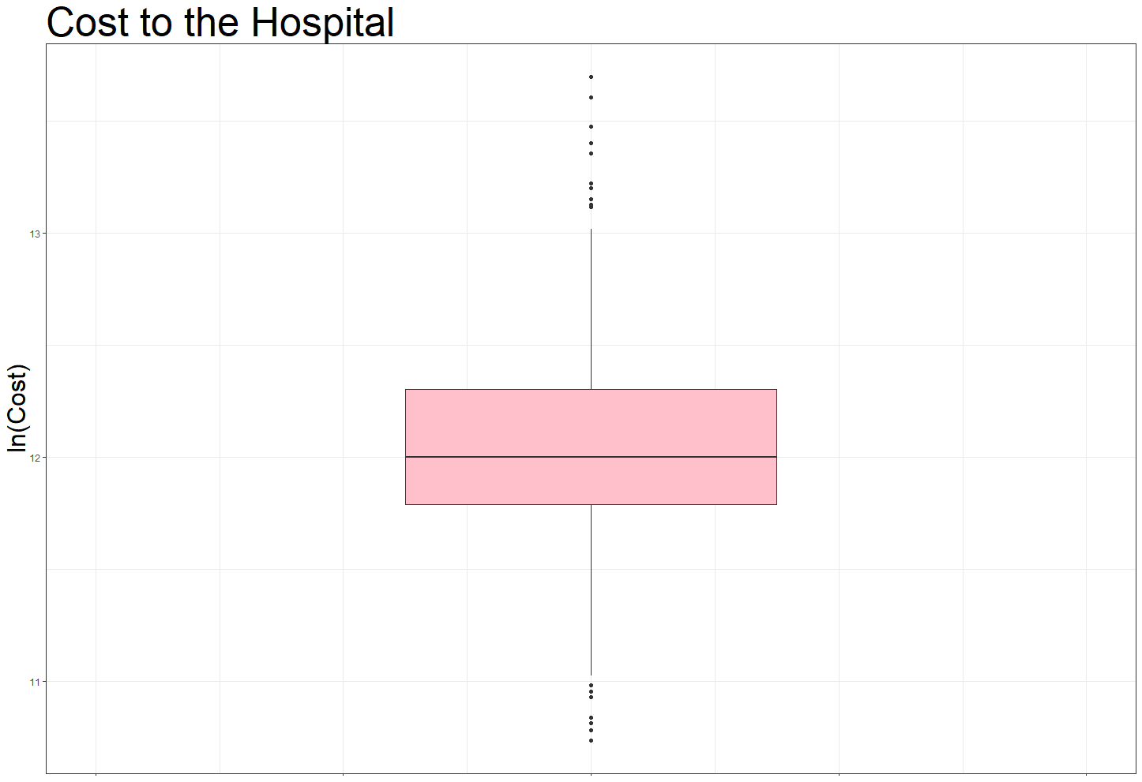
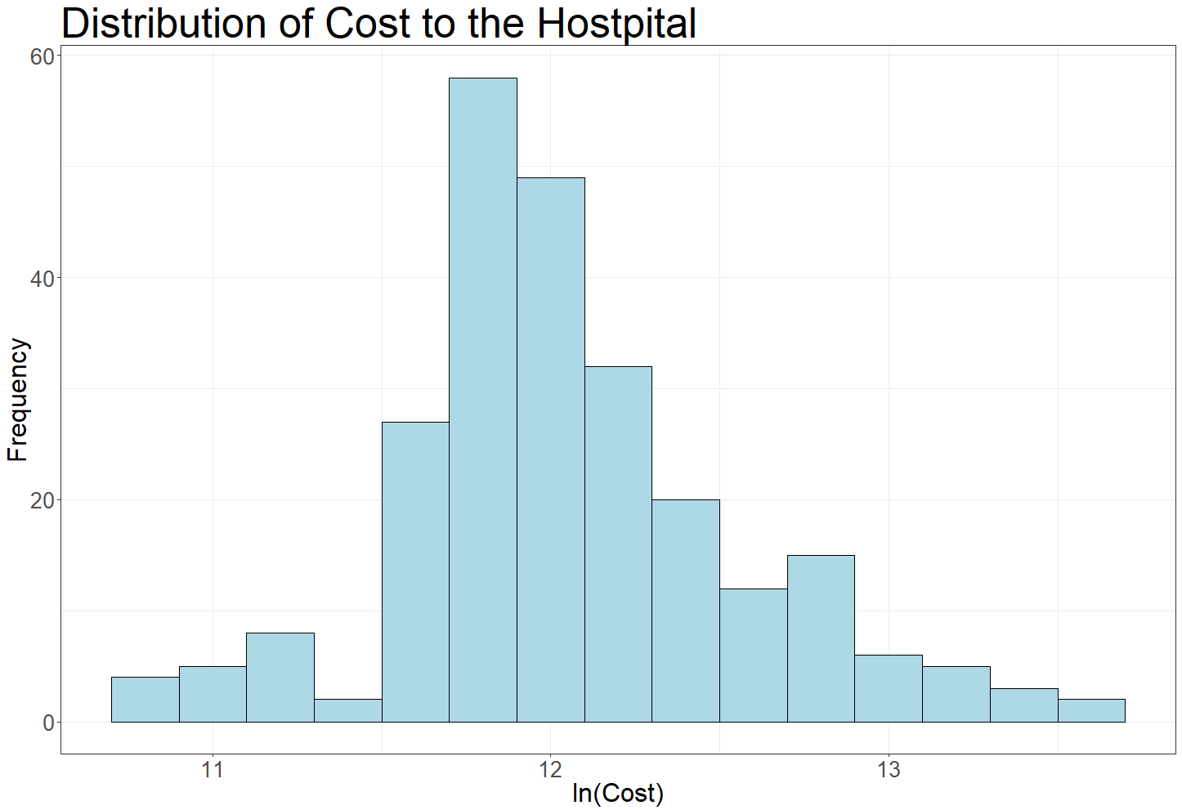
Dependent Variable - Cost to the Hospital
The Distribution of the 248 observations of Cost to the Hospital ranges from ₹46,093 to ₹887,350.
The median of the distribution is ₹162,661 with a much higher mean of ₹198,723.
There are quite a few high side outliers that give a right-tailed distribution.
We take the natural logarithm of the variable and plot again.

Slide 4
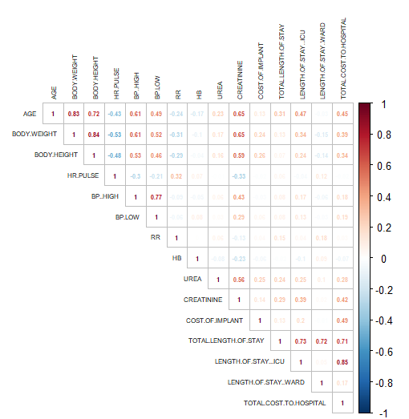
Correlation
Eliminated Total Length of Stay as its correlated with Length of Stay in the ICU and Ward
Body height and Weight are highly correlated. Hence used BMI for developing the model to avoid multicollinearity
BP-High and Low are correlated, hence considering only High BP for our analysis

Slide 5
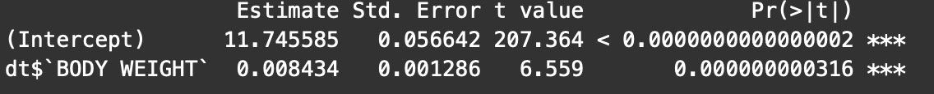
Total Cost
and
Body Weight
Body weight and total cost relationship
Equation: Ln(Total Cost) = 11.745+0.00843 (BodyWeight)
With a unit increase in the weight, there will be 0.84% increase in the total cost of the treatment

Slide 6
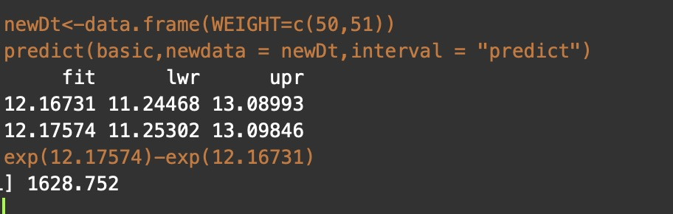
Total Cost
and
Body Weight
By calculation , a patient with 51kg is likely to spend at least 1000 INR more than a patient who weighs 50 kgs with 95% confidence interval.
In this case it is predicting a difference of 1628.
Mathematically we can say a person of 51kg will spend more than 50 kg but from healthcare point of view we can not assert this

Slide 7
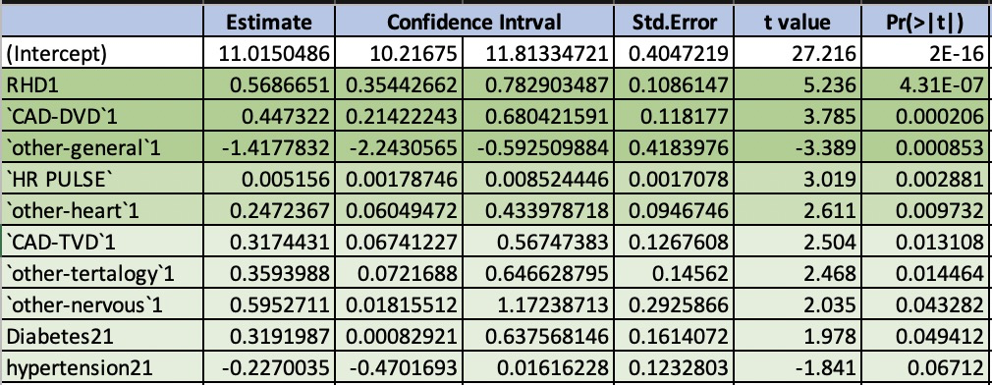
Multiple Regression
Significant Variables :
RHD1
`CAD-DVD`
`other-general`
`HR PULSE`
`other-heart`
`CAD-TVD`
`other-tertalogy`
`other-nervous`
Diabetes2
hypertension2

Slide 8
Inferences
If the key complaint faced by patient comes under ‘Others-General’, the cost of treatment will decrease by 24% when compared to a person who does not come with ‘Others-General’ as complaint code
If a patient comes in complaining of 4 related symptoms(tetralogy) then the predicted cost of treatment will increase by 43% when compared to a person who does not come with tetralogy as complaint code
If a patient comes in with Diabetes and Hypertension, then the predicted cost of treatment can increase by 37% when compared with a person who does not come in with Diabetes2 code

Slide 9
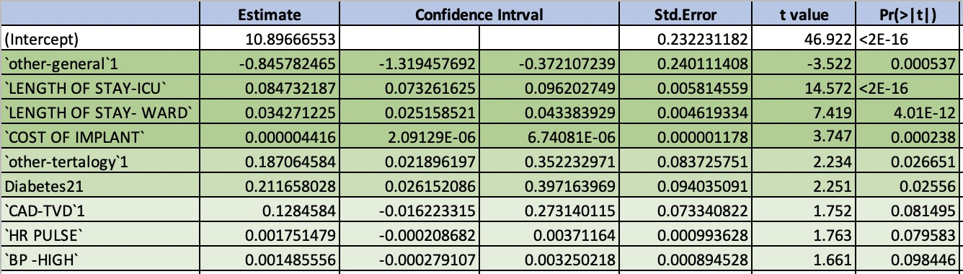
2. Multiple Regression
Significant Variables :
`other-general`
`LENGTH OF STAY-ICU`
`LENGTH OF STAY-WARD`
`COST OF IMPLANT`
`other-tertalogy`
Diabetes2
`CAD-TVD`
`HR PULSE`
`BP -HIGH`

Slide 10
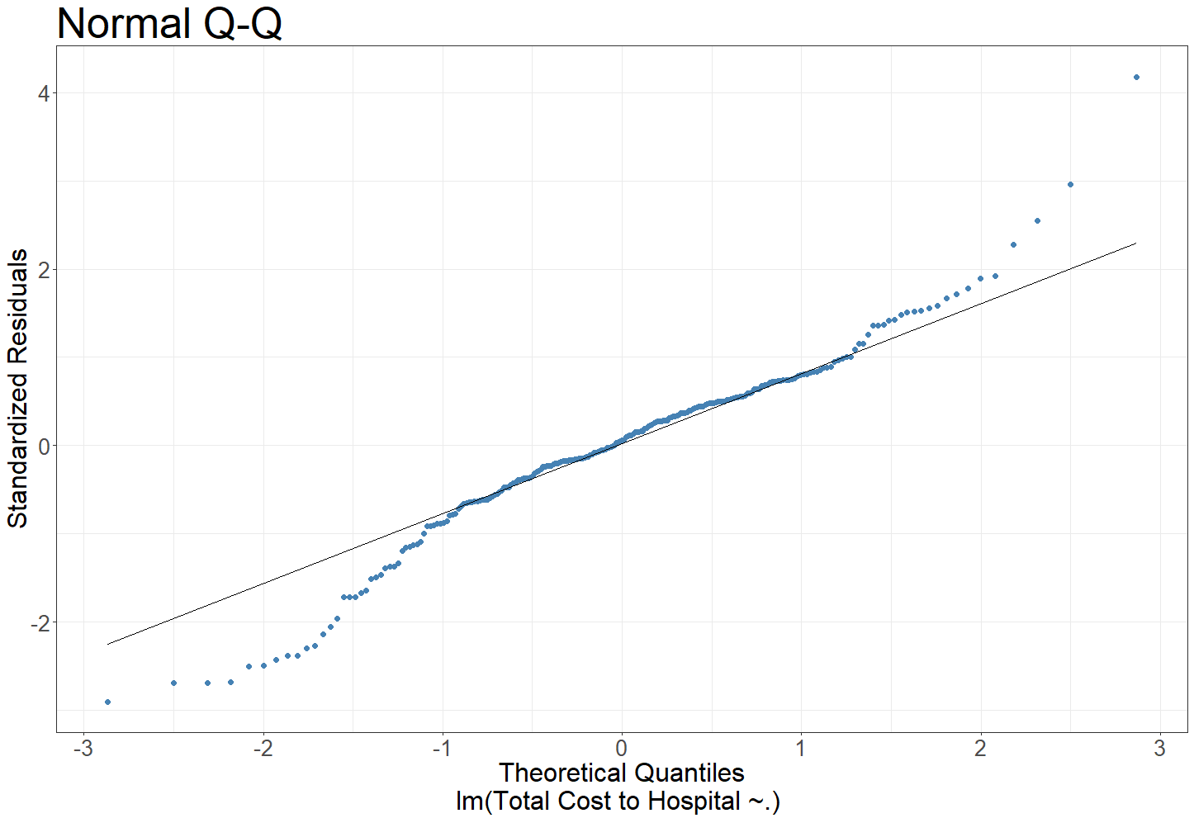
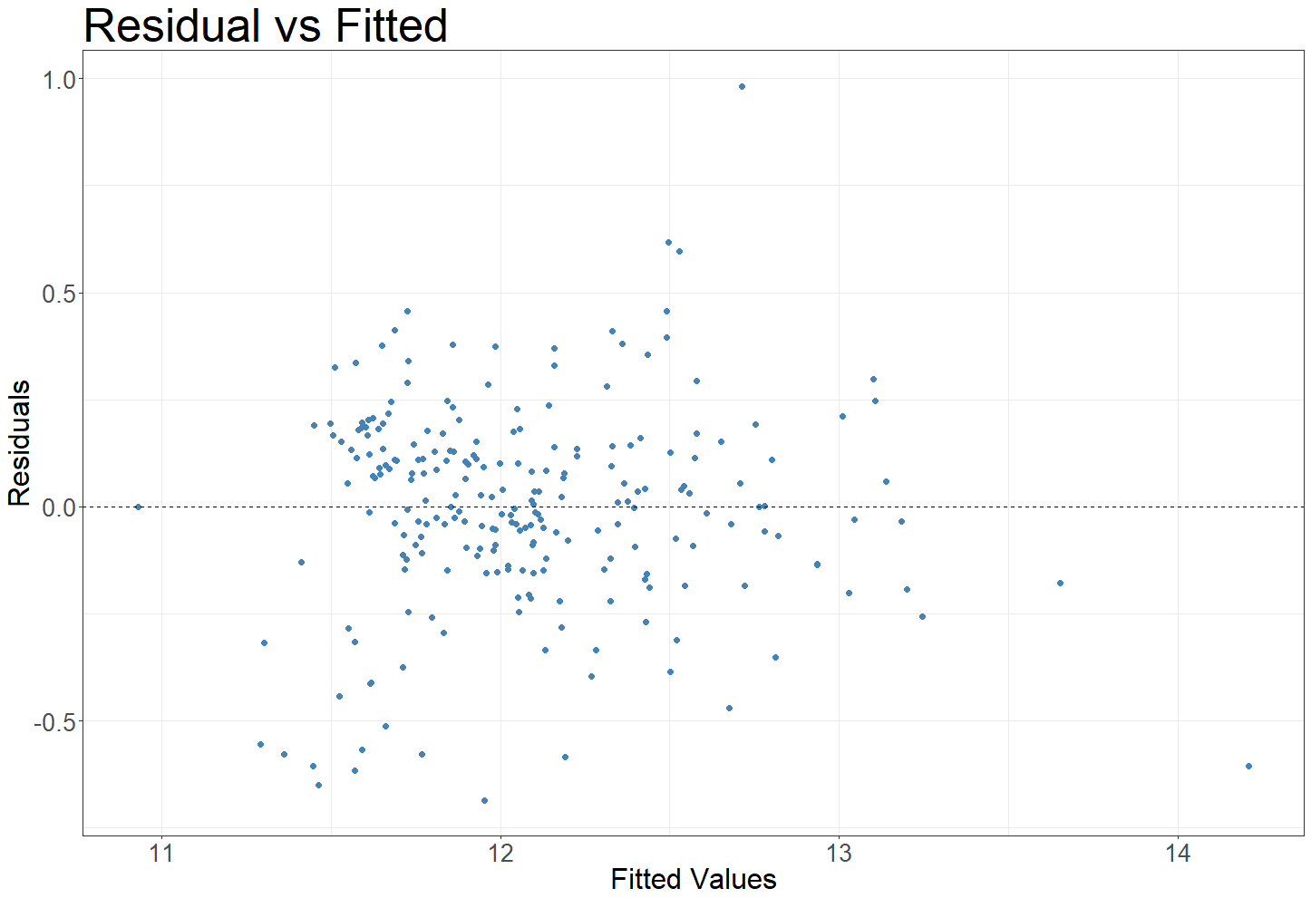
Normal Q-Q
Fitted vs Residual Plot

Slide 11
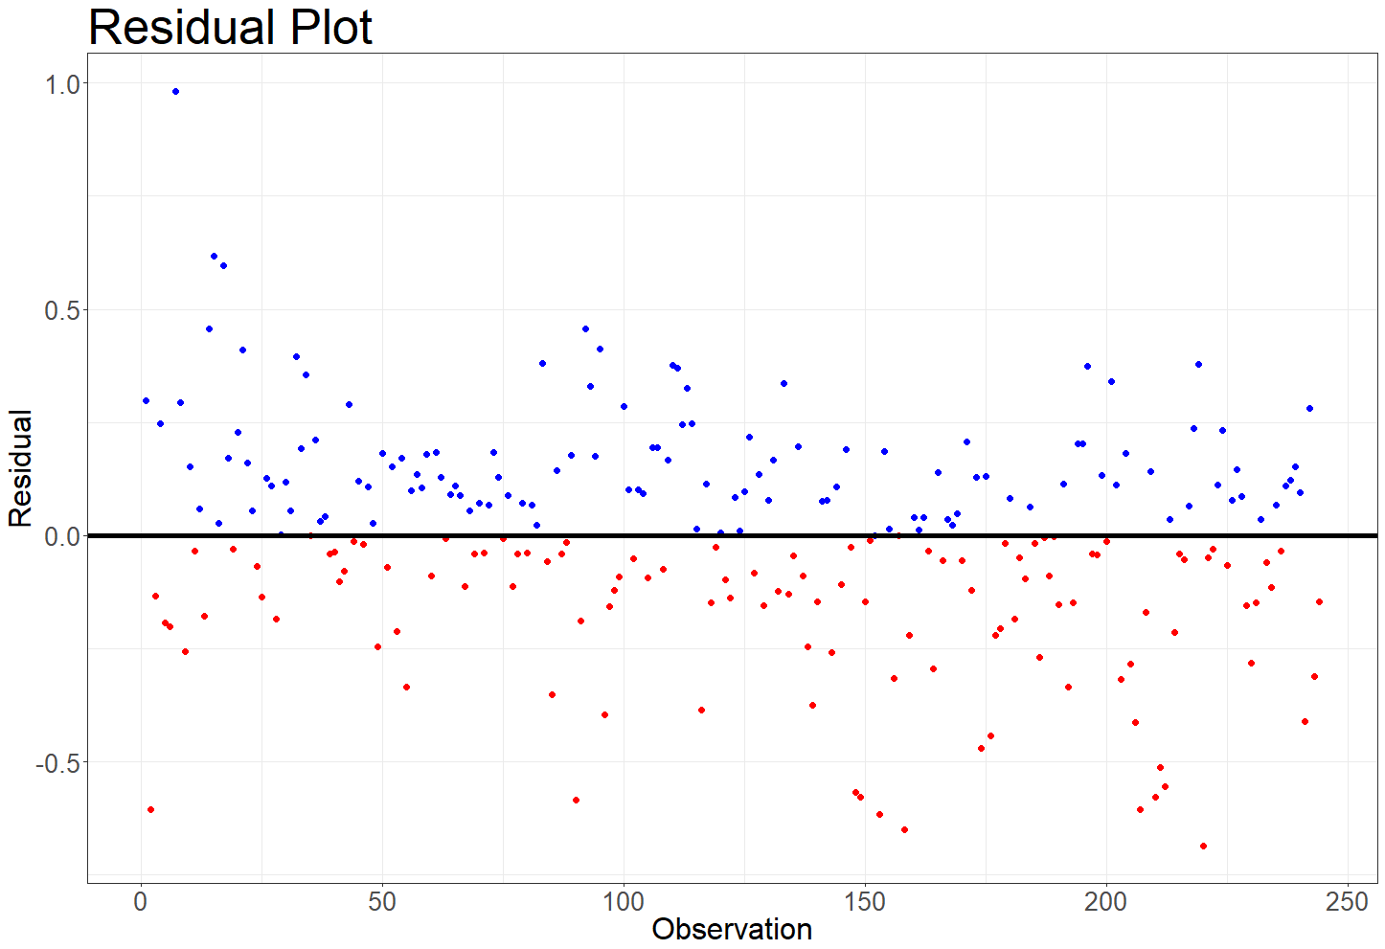
Residual Plot

Slide 12
Thank You

